Slide 1

CREDIT CARD FRAUD Detection
USING MACHINE LEARNING
SANTOSH GURUG

Slide 2

Table of Contents
What is a credit card fraud?
Who pays the price?
Why do we care?
How can we solve the problem
Demonstration using the Realtime dataset: About the dataset
Overview of the machine learning technique
Under sampling
Oversampling
SMOTE
Choosing the best machine learning model
Why certain models were not deployed?
Business scope
Conclusion

Slide 3
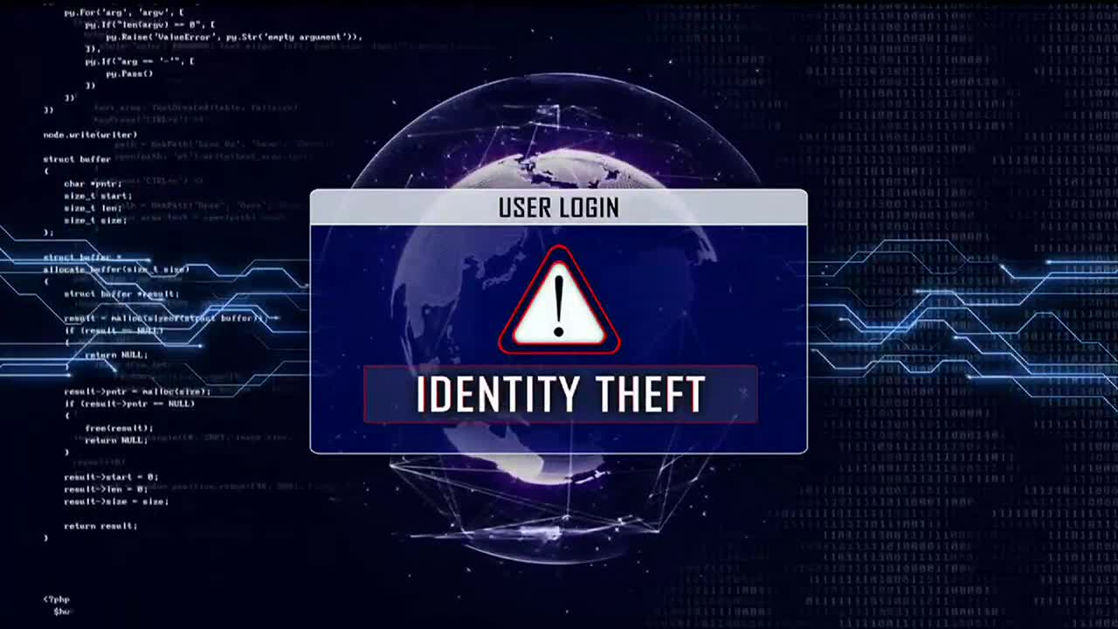
What is a credit card fraud?
An identity theft
Unauthorized individual or institution use your credit card to make transactions or acquire cash advances
Most Common Types of Credit Card Frauds
Phishing
Hacking
Skimming

Slide 4

Who pays the price?
Merchant
Cost of merchandise
Chargeback administration cost
Customer
Negative effect on the credit scores
Great deal of a time and aggravation
Bank
Cost millions f dollars
Reputation damage
Transaction fees
Might have to pay some penalties
Customer retention price

Slide 5
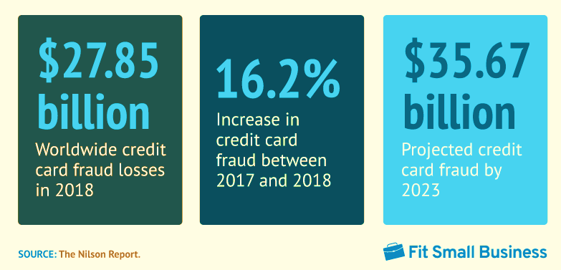
Why do we care?

Slide 6

How can we solve the problem?
Answer: Using Machine learning and AI
It can help reduce the fraudulent transactions
Many financial institutions have already adopted the advance AI to detect the real time credit card fraud
It can minimize the human effort and can dramatically reduce the cost.

Slide 7
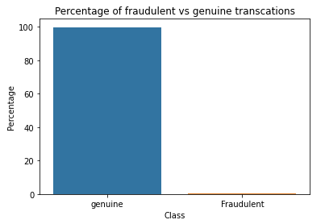
Demonstration using the real time dataset
About the data
Source: Kaggle
Contains:
credit card transactions of September 2013 by European cardholders
Only 492 fraudulent transactions out of 284,807 transactions
The positive class (fraud transactions) accounts only about 0.172% of all transactions

Slide 8
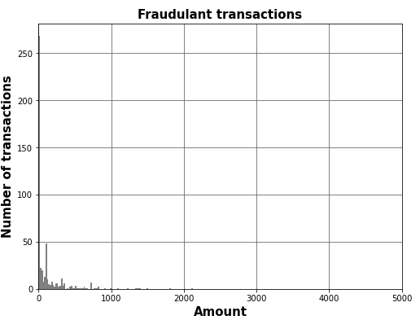
The number of fraudulent transactions are concentrated on lower amount

Slide 9

Overview of fraud detection technique
1. Under sampling
The number of the genuine transactions count will be reduced to 492 to equalize with the fraudulent transactions
2. Oversampling
Here we will make the same count of genuine transactions as fraudulent transactions
3. SMOTE
SMOTE (Synthetic minority oversampling technique) is also an oversampling technique which uses nearest neighbor algorithm to create synthetic data.

Slide 10
Under sampling
Logistic Regression
Train set
XGBoost
Train set
Test set
Random Forest
Train set
Test set
Test set
Accuracy = 0.97, Sensitivity = 0.87, Specificity = 0.97, ROC-AUC = 0.96
Accuracy = 0.95, Sensitivity = 0.92, Specificity = 0.98, ROC = 0.99
Accuracy = 1.0, Sensitivity = 1.0, Specificity = 1.0, ROC-AUC = 1.0
Accuracy = 0.96, Sensitivity = 0.92, Specificity = 0.96, ROC-AUC = 0.98
Accuracy = 0.94, Sensitivity = 0.89, Specificity = 0.98,ROC-AUC = 0.98
Accuracy = 0.98, Sensitivity = 0.83, Specificity = 0.98, ROC-AUC = 0.97

Slide 11
Oversampling
Logistic regression
Train set
XGBoost
Train set
Decision Tree
Train set
Test set
Accuracy = 0.95, Sensitivity = 0.92, Specificity = 0.97, ROC = 0.98
Accuracy = 0.97, Sensitivity = 0.89, Specificity = 0.97, ROC = 0.97
Test set
Accuracy = 1.0, Sensitivity = 1.0, Specificity = 1.0, ROC-AUC = 1.0
Accuracy = 0.99, Sensitivity = 0.80, Specificity = 0.99, ROC-AUC = 0.97
Test set
Accuracy = 0.99, Sensitivity = 1.0, Specificity = 0.99, ROC-AUC = 1.0
Accuracy = 0.98, Sensitivity = 0.78, Specificity = 0.99, ROC-AUC = 0.89

Slide 12
SMOTE
Logistic Regression
Train set
XGBoost
Train set
Test set
Decision Tree
Train set
Test set
Accuracy = 0.94, Sensitivity = 0.92, Specificity = 0.97, ROC = 0.99
Test set
Accuracy = 0.97, Sensitivity = 0.89, Specificity = 0.97, ROC = 0.97
Accuracy = 0.99, Sensitivity = 0.89, Specificity = 0.97, ROC-AUC = 1.0
Accuracy = 0.99, Sensitivity = 0.79, Specificity = 0.99, ROC-AUC = 0.96
Accuracy = 0.98, Sensitivity = 0.79, Specificity = 0.98, ROC-AUC = 1.0
Accuracy = 0.98, Sensitivity = 0.80, Specificity = 0.98, ROC-AUC = 0.86

Slide 13
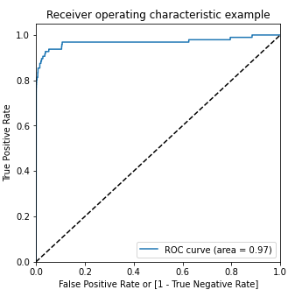
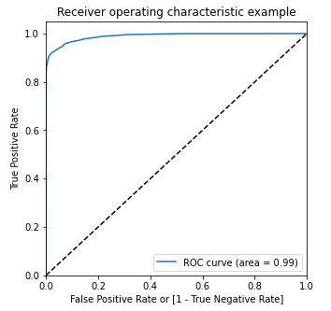
Selecting the best machine learning model
The SMOTE model performed better with this dataset
The logistic regression model under the SMOTE technique has ROC score 0.99 in the train set and 0.97 on the test set
Logistic model as the best model to choose because of the easy interpretation of the models and the resource requirements

Slide 14
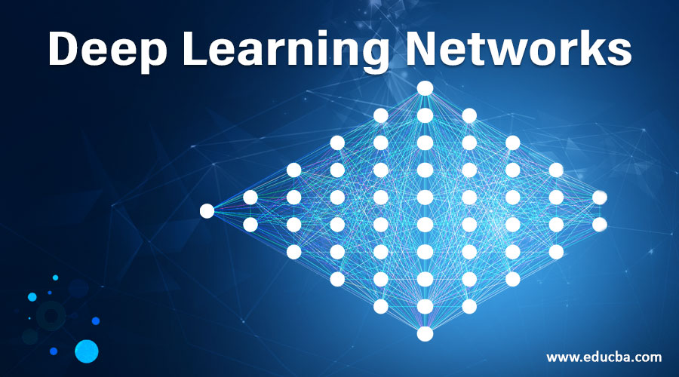
WHY KNN WAS NOT USED FOR MODELING?
KNN is not memory efficient
It becomes very slow as the number of datapoints increases as the model needs to store all the data points
It is computationally heavy because for a single datapoint the algorithm needs to calculate the distance of all the datapoints and find the nearest neighbors.
Why SVM was not used for modeling?
SVM is not very efficient with large number of datapoints because it takes a huge computational power.
It is very time consuming to perform cross validation with K-Fold for hyperparameter tuning

Slide 15

Business Scope
Using Machine Learning financial institutions can save billions of dollars by:
Detecting fraud automatically
Real-time streaming
Greater accuracy
Less manual work
Ability to adapt and evolve

Slide 16
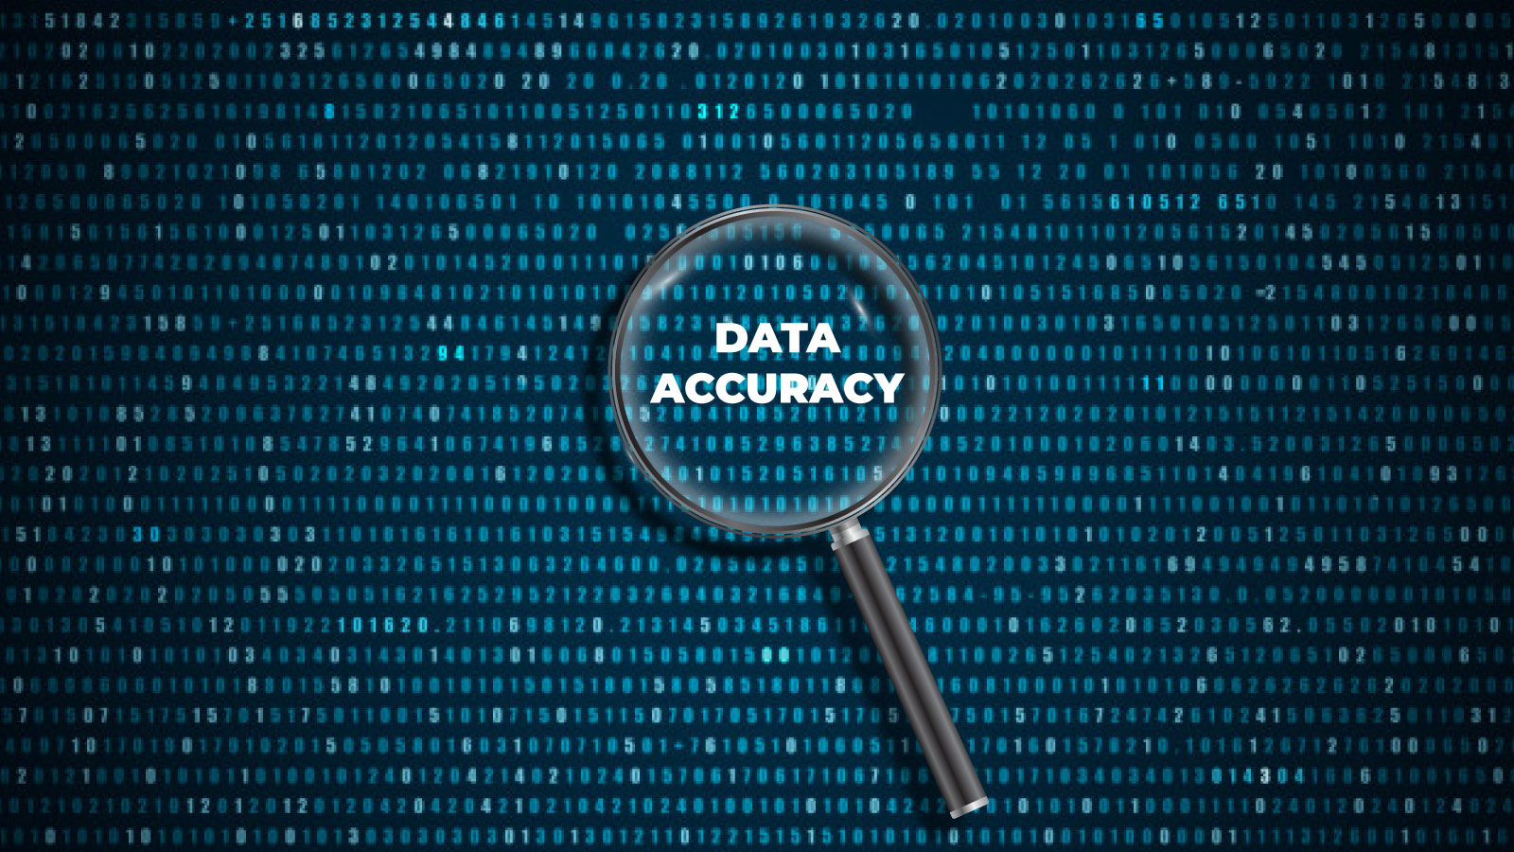
CONCLUSION
Though these machine learning models, and AI cannot prevent but ca play a great role to reduce and prevent the overall fraud with a great accuracy.
Machine learning models are superior in spotting fraudulent or anomalous transactions
This machine learning solution can help to save customers data, billions of dollars and intellectual property.
Financial institutions and banks must deploy machine learning models that can detect suspicious transactions in almost real-time, stop it immediately from happening and alert the authorities.

